Slide 1
College of Emerging Technology
Graph Modeling
Notes:
Welcome to this Optum Tech University course on Emerging Technologies

Slide 2
Welcome
Instructor Name:
Format: Four hour hands-on course with lecture and labs
Prerequisites:
All users must have passed the "Introduction to Graph Modeling" course on LearnSource or be familiar with graph databases
All users must have access to their own TigerGraph GraphStudio either by using a Docker image or a virtual machine

Slide 3
Learning Objectives
After this course students will be able to:
Understand the components of a Labeled Property Graph (LPG)
Understand the tradeoffs of using various LPG components
Understand how generalization and specialization can be modeled
See how geospatial data can modeled in a graph
Understand how temporal modeling can be done in a graph

Slide 4
Course Strategy
Teach the overall principles of modeling with a labeled property graph
Use the TigerGraph GraphStudio as a modeling tool
Concepts learned are applicable to any labeled property graph
Neo4j
MemGraph
etc.

Slide 5
Agenda
Brief review:
What is a graph database
How is a graph database different from a relational database
TigerGraph, GSQL, Giraffle
Hands on lab: Create a simple Doctor-patient model
Hands on lab: Loading synthetic patient data

Slide 6
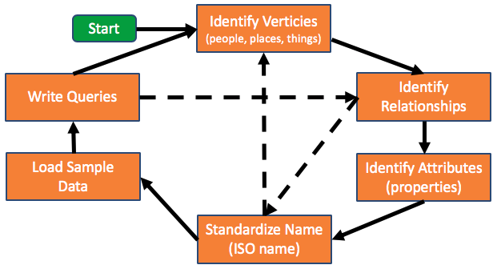
Graph Modeling is Iterative

Slide 7
Section 1
Graph Review

Slide 8
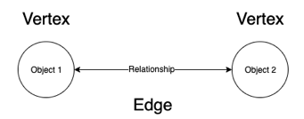
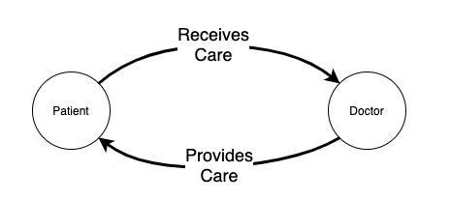
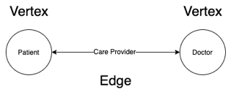
Elements of a Graph
In mathematics a graph is a structured set of objects in which pairs of objects may or may not be related
The objects are abstractions called nodes or Vertices
The relationships between a pair of objects is call an Edge
A doctor and their patients are related by the following relationships, or edge types
Doctors provide care for patients
Patients receive care from a doctor

Slide 9
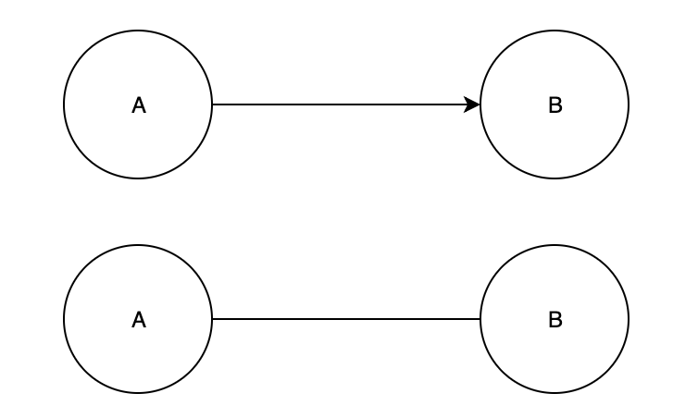
Edge Types
In graph databases, relationships are first-class citizens and there is little cost for traversing relationships.
When modeling relationships between vertices A and B there are two types of edges:
Directed - The relationship exists only from A to B.
Undirected - The relationship exists from A to B and from B to A.

Slide 10
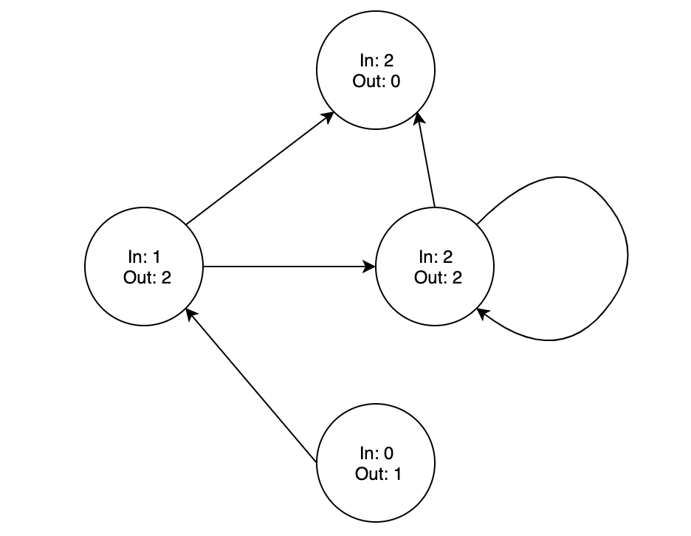
Vertex Degree
In graph modeling it is also important to consider how the relationships between objects help describe and provide additional context.
Degree - The number of incident edges to a vertex.
A self incident edge, or Loop, counts as two degrees.
When edges are directed then the degree can be further clarified as
Indegree - The number of incident edges that end at the vertex.
Outdegree - The number of incident edges that end at the vertex.

Slide 11
Section 2
Graphs as a Storage Solution

Slide 12
Databases and Management Systems
The term Database, or DB, is not a foreign term to the majority of people in the workforce.
Most people have heard of or interacted with the following: SQL, SQL Server, Microsoft Access, etc.
In addition to the underlying storage of data the term Database Management System, or DBMS, refers to the software system that enables a user to interact with the underlying DB.
There are many ways to classify DBs, but for simplicity the focus will be on Relational and Non-Relational.

Slide 13

Relational Databases
In a Relational Database Management System, or RDBMS objects are modeled into one or more Tables of rows and columns.
Rows are generally referred to as Records or Tuples.
Columns are called Attributes.
Microsoft SQL Server is an example of a RDBMS.

Slide 14
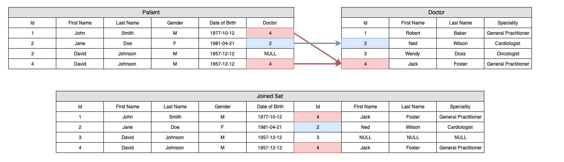
Relational Database Joins
Combining information in a RDBMS requires the use of JOINs, which relate objects in one set to the objects in another set.
Relating objects between sets can be a very expensive operation if the data is voluminous or is unorganized.

Slide 15
Non-Relational Databases
By contrast Non-Relational Databases provide mechanisms for storage and data retrieval differently than the tabular relations used in RDBMS.
There are many different types of Non-Relational Database and Graph databases are just one example, another is a Document Database.
It is not uncommon for graph engines to even interact with traditional relational database storages

Slide 16



Graph Database Structure
Graph databases use graph structures as their storage mechanism, which consist of the following:
Vertices - Represent entities or instances
much like record in a RDBMS
Edges - Represent the relationships
between Nodes
Properties - Attributes associated with
Nodes and edges
Among graph databases there are many
different types and models.
Examples of Graph Databases
Cambridge
Semantics

Slide 17
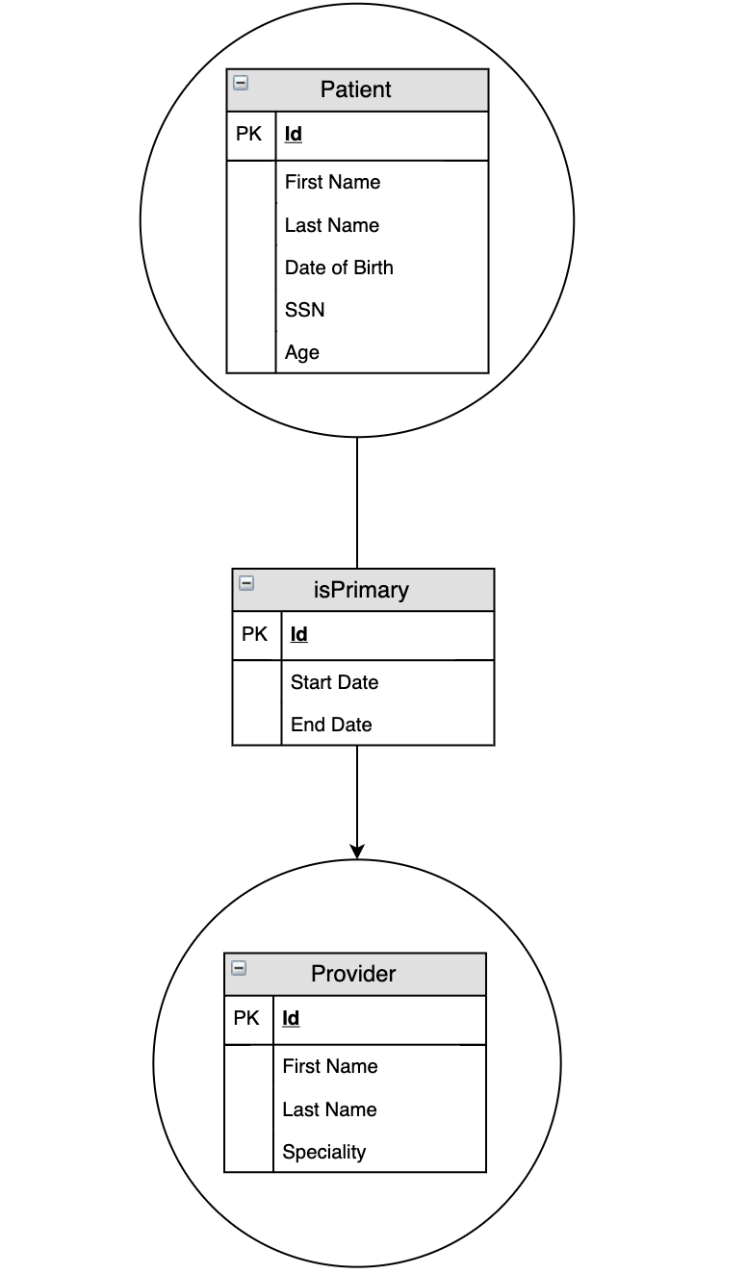
Labeled Property Graph
Labeled-Property Graph, or LPG are by far the most popular type of graph database
In LPGs Nodes and Edges are simply named, or Labeled.
Additionally Vertices and Edges can store Key-Value pairs, or Properties, that represent attributes.
Defining properties on objects can have a tremendous impact the architecture of the overall graph model

Slide 18
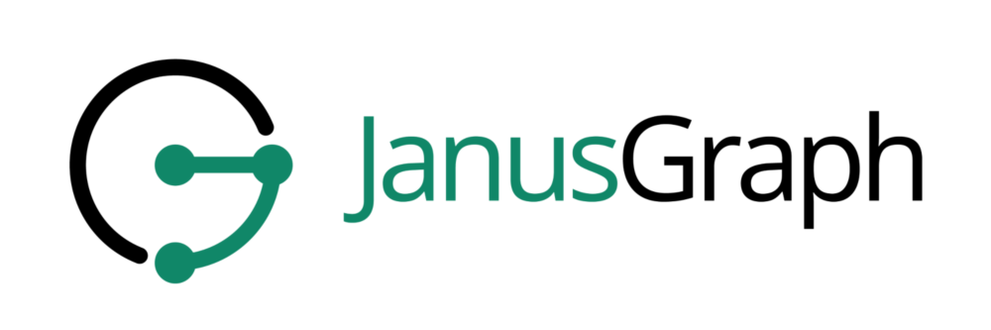

Graph Query Language
As opposed to RDBMS where SQL exists, there is no standardized query language. Two of the more popular query languages are
Gremlin - JanusGraph query language
and part of Apache Tinkerpop
Cypher - Designed originally for Neo4j

Slide 19
Graph DB and Traditional RDBMS Comparison
The priority placed on relationships is a defining characteristic of graph databases.
Relationships are defined as “First Class Citizens” in graph databases, which translates to relationships having the same support of operations as the underlying entity data
However in a RDBMS relationships are inferred by comparing a foreign key property on records

Slide 20
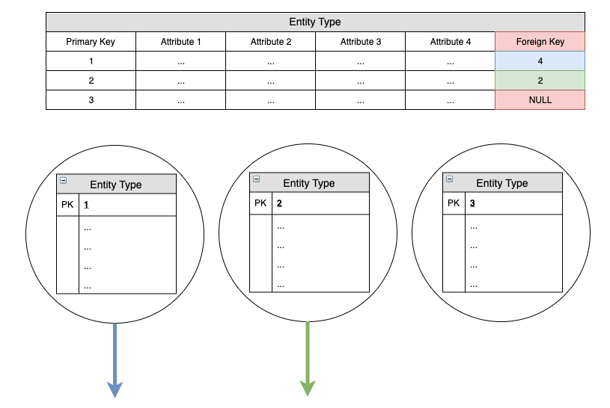
Graph DB and RDBMS Relationship Comparison
This further highlights a difference between graph database and RDBMS
Relationships are defined at a record level for graph databases
In RDBMS modeling the relationship is defined at a table level
When there is no relationship present there still must be NULL value, but in a graph database the relationship simply wouldn’t exist.

Slide 21
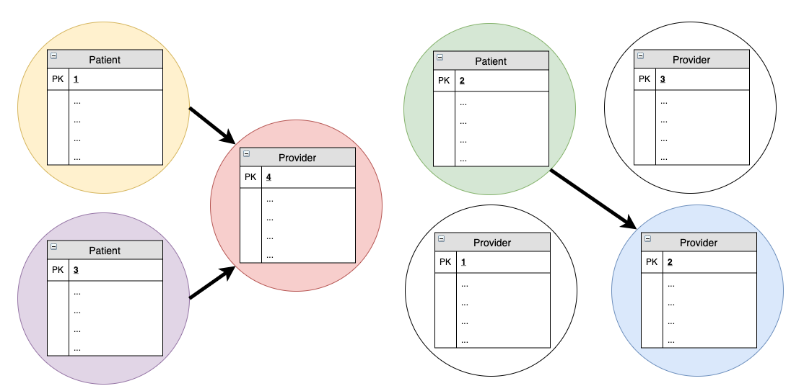
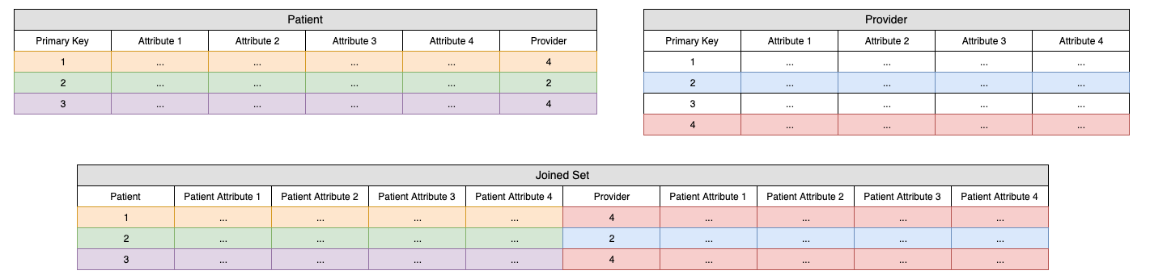
Traversal of Data Opposed to Sets of Data
The fundamental interaction with the data is very different
Graph databases traverse relationships paths to form connections between data
RDBMS operate on sets of data must form relationships based matching properties between objects in sets
Recursive relationships in particular tend to be very expensive as successive JOINs must be used.

Slide 22
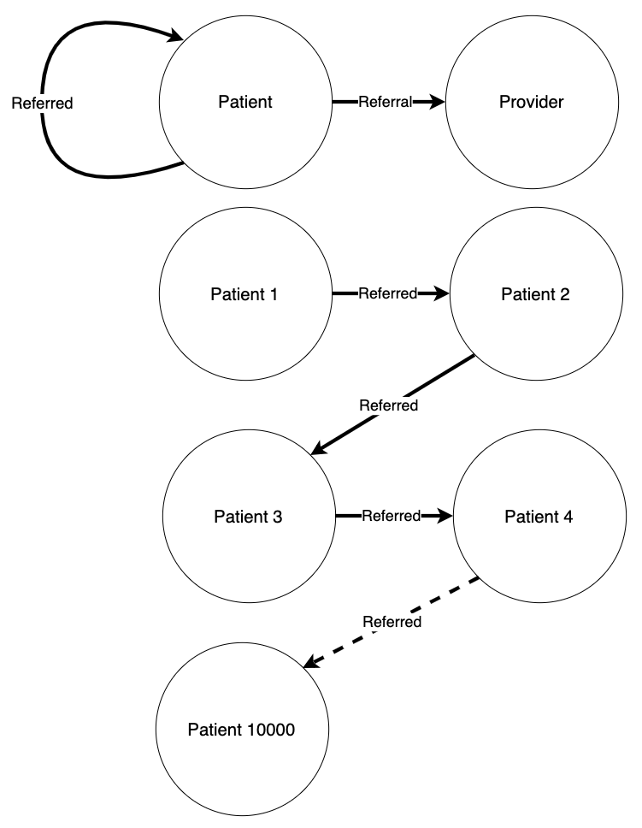
Traversals of a Graph Model
Consequently since graphs must be traversed it is important to limit the traversals to smaller defined sets, or subgraphs.
Use property values as well as vertex and edge types to limit the query search range
When querying or modeling graph data be aware of recursive relationships that allow for infinite scope
For example if patients are related to other patients by “referrals”
Understanding the underlying model and limiting interaction to subgraphs is a key aspect when querying a graph database.

Slide 23
When are Graph DB Solutions Useful?
RDBMS tend to be more useful when
Data is structured in a Consistent Form
Aggregation of Data
Auditing and versioning of Data
Graph DBs tend to be more useful when
The priority, context or existence of a relationship between entities is emphasized
Entities are not as uniform
Data Analytics

Slide 24
Do I have a Graph Database Problem?
Graph DBs are not always the solution. There are certain questions to ask, which can help determine if a Graph DB would be beneficial.
Is my data extremely interconnected?
How important are the relationships in the data model?
Is the way the data is connected as important, or possibly even more important than the actual data?
Are their graph algorithms that help address or provide answer to queries in the data model?
Depending on the above answers a Graph Database may be the ideal solution.

Slide 25
Exercise 2 Graph Databases
What are the components of a graph?
What are the two types of edges?
Why would the degree of individual vertices be important when modeling?

Slide 26
Exercise 2 Graph Databases
What are the components of a graph?
Vertices and Edges (Group Question)
What are the two types of edges?
Directed and Undirected (Group Question)
Why would the degree of individual vertices be important when modeling?
Discussion question to help lead into next section instructor should highlight record facing aspect. Tying into Supernodes would be good as the next section begins with data population

Slide 27
Section 3
Introduction to TigerGraph

Slide 28

TigerGraph
The rest of the modeling exercises will be completed using TigerGraph
Created 2017 and implemented in C++
A complete, distributed, parallel graph computing platform
Implements own graph storage engine and graph processing engine

Slide 29
GSQL
TigerGraph implements its own query language, GSQL
Schema-Based and parallelized
“SQL-Like” and supports parameterized queries, which can be used to build more complex queries

Slide 30
TigerGraph Features and Uniqueness
Schema Enforced
Not all Graph DBs require a schema. For example in Neo4J schemas optional and non-existent in Tinkerpop
No Indexes
There is no explicit indexing for TigerGraph unlike Neo4J for example, which supports single-property indexes and composite indexes

Slide 31
Getting Started with TigerGraph
Materials for this course have been collected in the following zip
Download Link to Zip
Once the zip has been downloaded then run the following command
“docker load -i TigerGraphOptum.tar”
Once the images have been loaded run the following
“docker-compose run tigergraph_client”
There should now be an interactive instance of the TigerGraph client running as well as an instance of the TigerGraph server.
Once the TigerGraph Server has been initialized, please open a browser and proceed to “localhost:4142” to start using TigerGraph Studio

Slide 32
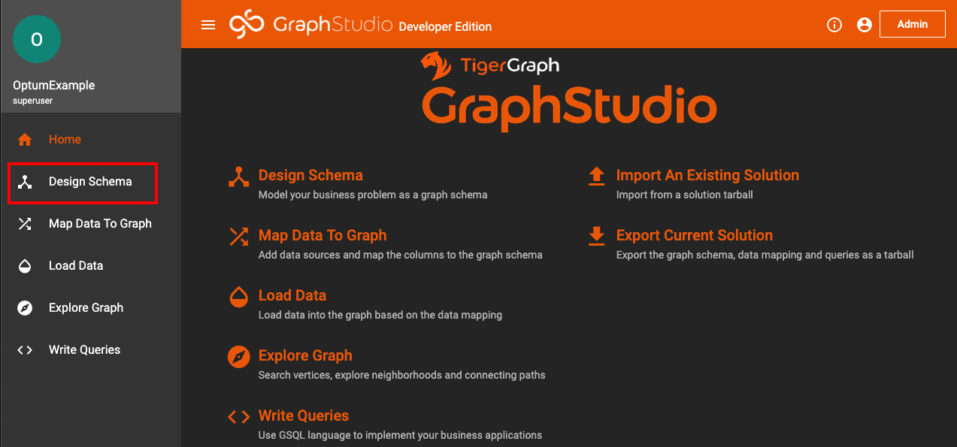
Design Schema TigerGraph Studio
Once an instance has been initiated the Tigergraph Studio will be used for this section to create vertices and edges through the UI
The first action is to start designing a schema

Slide 33



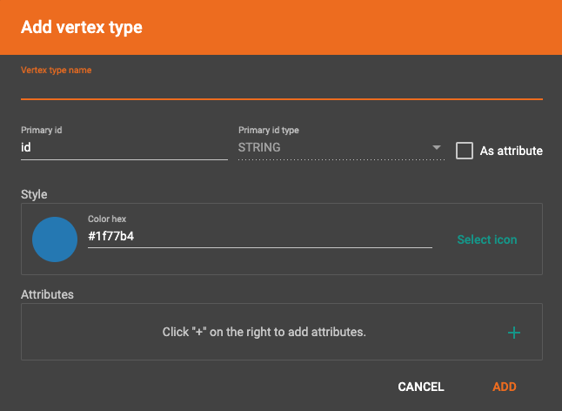
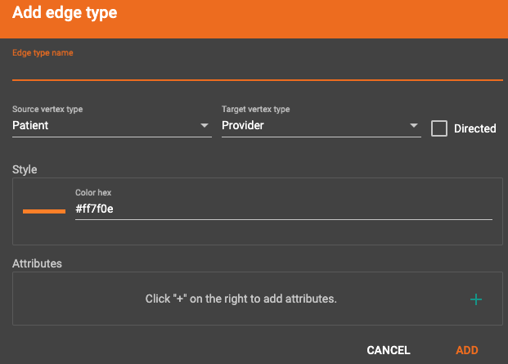
Creating Nodes, Edges and Graphs in TigerGraph
Creating a Vertex Type
Click on add vertex
Fill out properties for the vertex type
To create an edge click on a vertex and click on add edge
Fill out properties for the edge type
After vertices and edges have been added click to create graph or publish the schema
For the course everyone has their own TigerGraph instance, but when working in a shared environment publishing would impact everyone using the shared instance

Slide 34
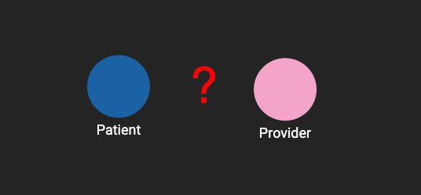
Designing a Simple Schema in TigerGraph
Start with the simple case of patients and a providers
How are these two concepts typically related?

Slide 35
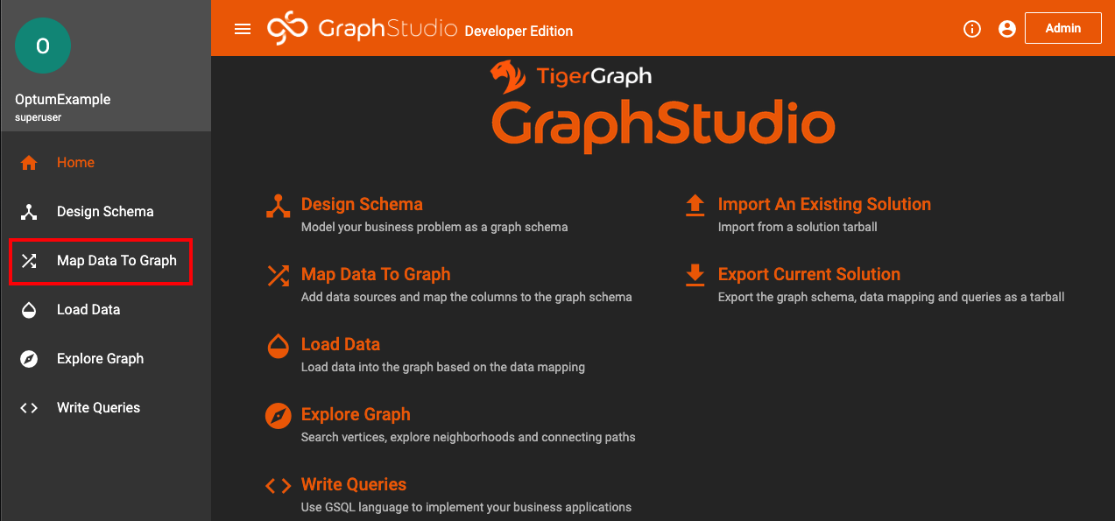
Mapping Data TigerGraph Studio
Now that the basis for a schema exists it is time to start populating the schema with data
Start by selecting “Map Data To Graph”

Slide 36
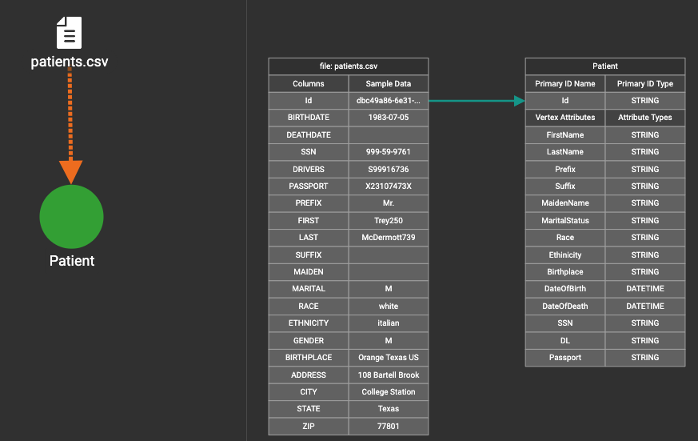
Mapping Data Sources in TigerGraph
TigerGraph Studio allows populating schema objects by adding data sources
After a data source has been added the contents can be mapped to objects
Finally the contents of the data source can be mapped to the schema object as shown

Slide 37

Mapping Data TigerGraph Studio
Once there is a schema, a data source and a mapping then data can be propagated in the graph
Select “Load Data” to proceed

Slide 38
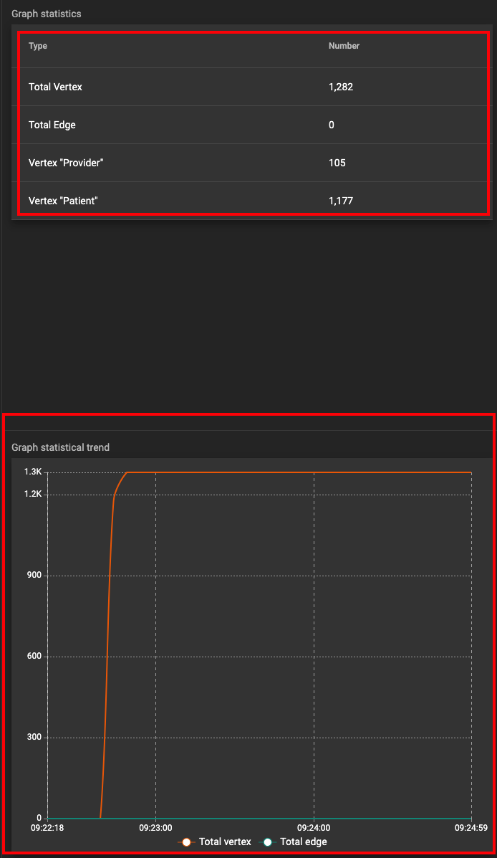

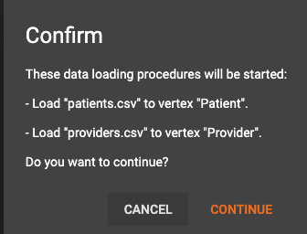
Loading Data in TigerGraph
Starting a load job in TigerGraph is as easy as selecting the following icon
Confirm when prompted to begin loading data.
When there are multiple data sources defined starting the load job will initiate all
Shows current vertices and edges in the graph
Provides insight into statistics of the data loading

Slide 39

Explore Graph TigerGraph Studio
All pieces have now been setup
There is a schema
Defines vertex and edge types
There is a data source and mapping
Defines how to translate a source into an individual vertex
There is a load task
Populates data within the graph
Time to Explore the graph by selecting “Explore Graph”

Slide 40
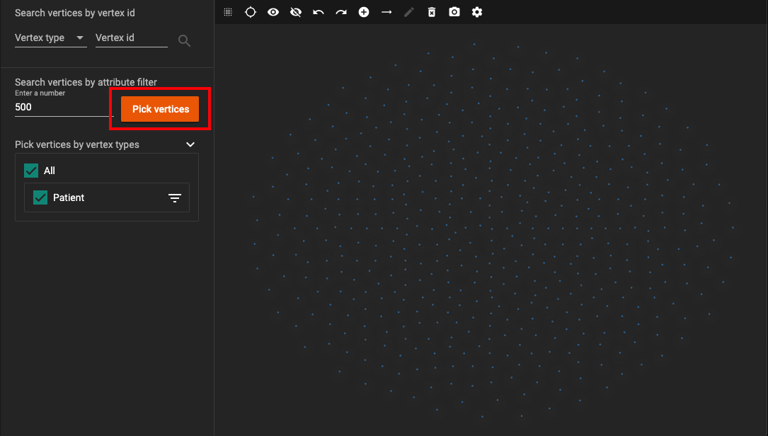
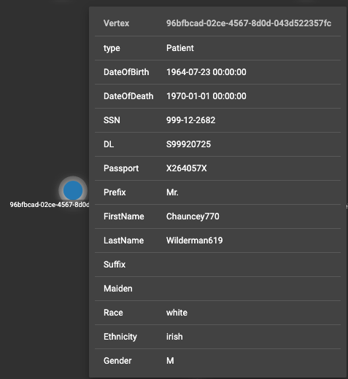
Exploring Data in TigerGraph Studio
Data in a graph can be voluminous and TigerGraph studio limits selections to 500 vertices at a time
Select “Pick vertices” to see data that currently exists within the graph
Hovering over a vertex will allow you to see the individual vertex properties

Slide 41
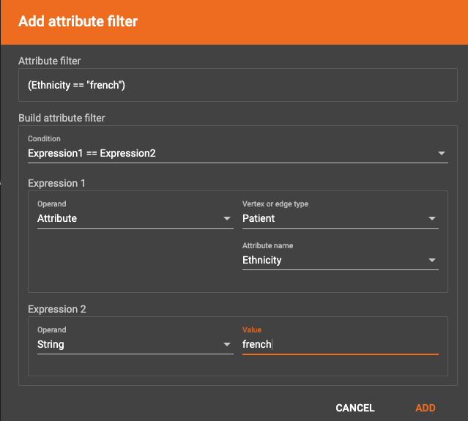
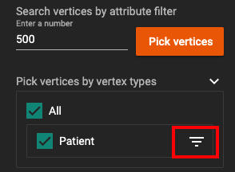
Attribute Filters in TigerGraph Studio
Vertices can be filtered by vertex or a given attribute
Click on the filter icon to define a custom filter
Selecting the following will hide what is currently being shown
This cleanly allows new filtered queries to be run
The above limits the selection of patient vertices to those who have a “french” ethnicity
Remember when comparing strings, “French” =/= “french”

Slide 42
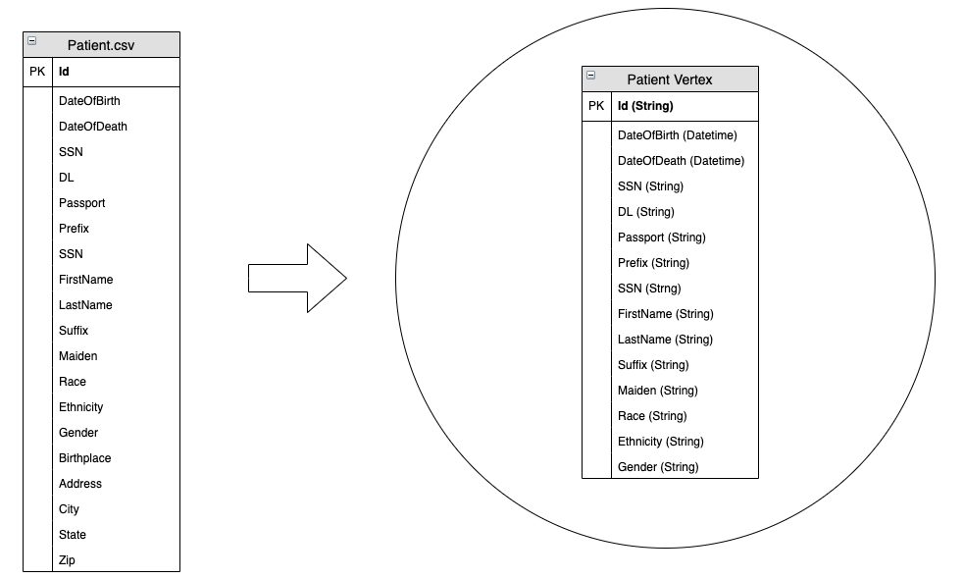
Exercise 3 Populating the Patient Vertex Type
First update the “Patient” object schema with the following attributes found in “patient.csv”
In this example not all attributes were mapped from the data source
What reasons are there for not modeling “Birthplace”, “Address”, “City”, “State” and “Zip”?
Additionally when creating “DateOfDeath” set the default value to “2999-12-31 00:00:00” as a way to separate living and deceased patients

Slide 43
Exercise 3 Exploring the Patient Data
How many patient vertices are there all together?
What is the name of the patient with SSN, “999-37-6355”?
What is the ethnicity of the patient with passport, “X55997743X”?
What is the date of birth of the patient with DL, “S99915145”?

Slide 44
Exercise 3 Exploring the Patient Data
How many patient vertices are there all together?
1,177
What is the name of the patient with SSN, “999-37-6355”?
“Etta748”, “Gulgowski916”
What is the ethnicity of the patient with passport, “X55997743X”?
“puerto_rican”
What is the date of birth of the patient with DL, “S99915145”?
“1932-01-31 00:00:00”

Slide 45
Section 4
TigerGraph GSQL

Slide 46
Using Gradle for TigerGraph Tasks
Go to the running client instance and type “gradle tasks” to see a list of tasks that can be executed
“loadExercise4”, “loadExercise5”, “loadExercise6”, “loadExercise7”
Execute the following command, “gradle loadExercise4”, to create the Patient, Visit, and Provider Vertex Types, associated edge types schema, load data for the schema and create and install a select few queries
To validate everything worked as expected use “gsql” to start a “GSQL” CLI instance and type “LS”
In the same GSQL terminal type “USE GRAPH OptumExample” followed by “RUN QUERY PatientQueryExample(“M”)”

Slide 47
Gradle Tasks use Giraffle
Giraffle is a Gradle DSL plugin for TigerGraph.
Available at https://github.com/Optum/giraffle/
Allows for easy execution and scheduling and grouping of GSQL commands from .gsql files.
Can work in conjunction with Properties Plugin, which allows an easy way to use and configure different environments
https://github.com/stevesaliman/gradle-properties-plugin

Slide 48

Write Queries TigerGraph Studio
TigerGraph studio offers one more option
The ability to define and install queries
There is support for very complex queries and advance control structures
Begin by selecting “Write Queries”

Slide 49
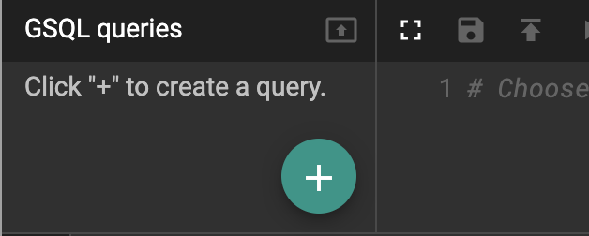
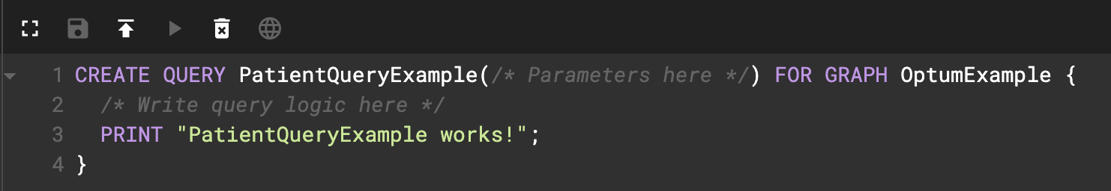

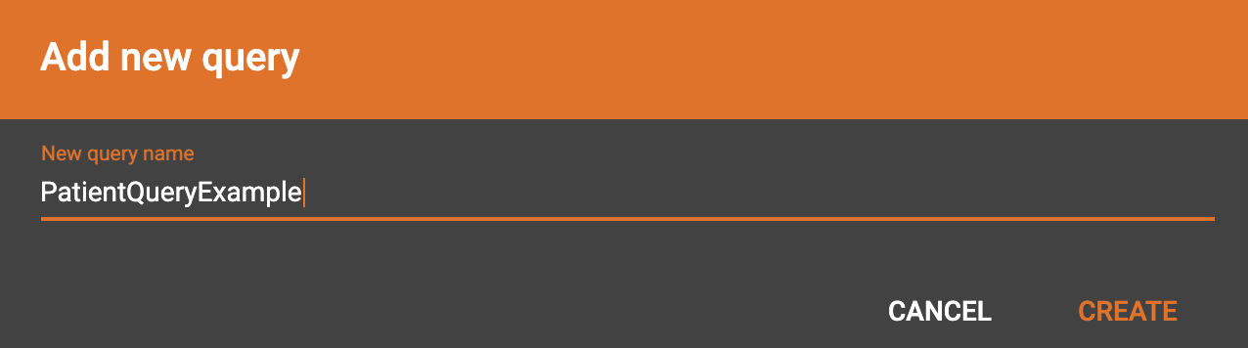

Running Queries in TigerGraph Studio
Select “New GSQL Query”
Create a new query, “PatientQueryExample”
Should now see the following created query
Install the query
Finally run the query

Slide 50
Introduction to GSQL
GSQL is very powerful in the TigerGraph studio and far more time could be spent simply reviewing the querying capabilities of TigerGraph
However it can be overwhelming if all that is needed are simple select statements
TigerGraph also provides a Command Line Interface (CLI) that allows the execution of GSQL
It can also be used to execute installed queries as well

Slide 51
Using GSQL CLI
Going back to the running docker instance of the TigerGraph client start a GSQL session by simply typing “gsql”
Should see “gsql >” and to exit gsql type “exit”
TigerGraph also provides a Command Line Interface (CLI) that allows the execution of GSQL commands without the overhead of installing queries in TigerGraph studio
The select functionality afforded is not as expansive as installing a query
Run the following commands to find all english male patients
“USE GRAPH OptumExample”
“SELECT FirstName, LastName FROM Patient WHERE Gender == "M" AND Ethnicity == "english" LIMIT 1000”

Slide 52
Create and Populate a Subgraph with Giraffle
Open a shell to your docker image
Change your directory to the workspace project
Use "ls" to verify there is a gradle.build file
Type "gradle tasks"
Type "gradle loadPatients"

Slide 53
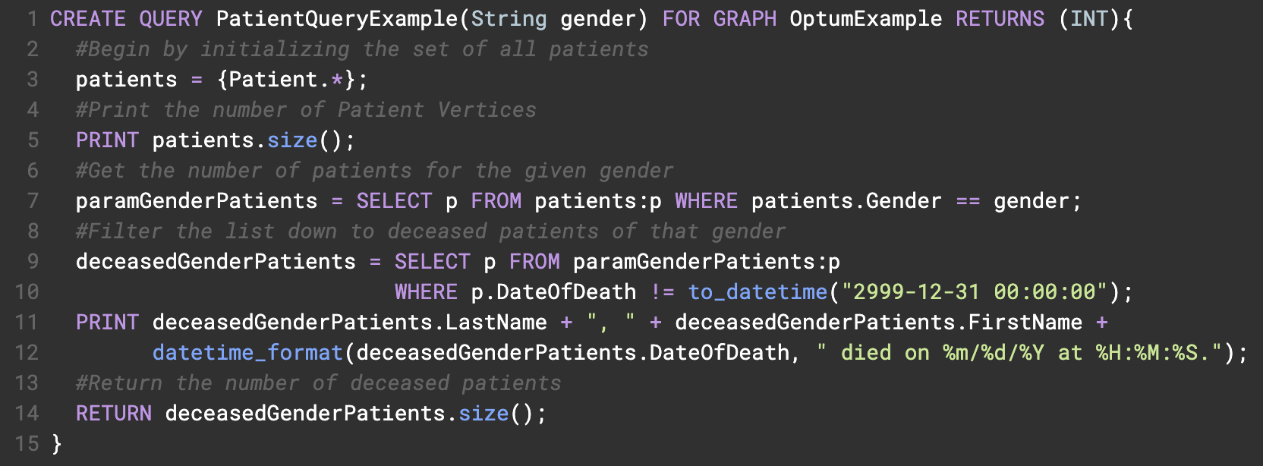
Patient Query Example
Go to TigerGraph studio and “Write Queries” to take a closer look at the PatientQueryExample

Slide 54
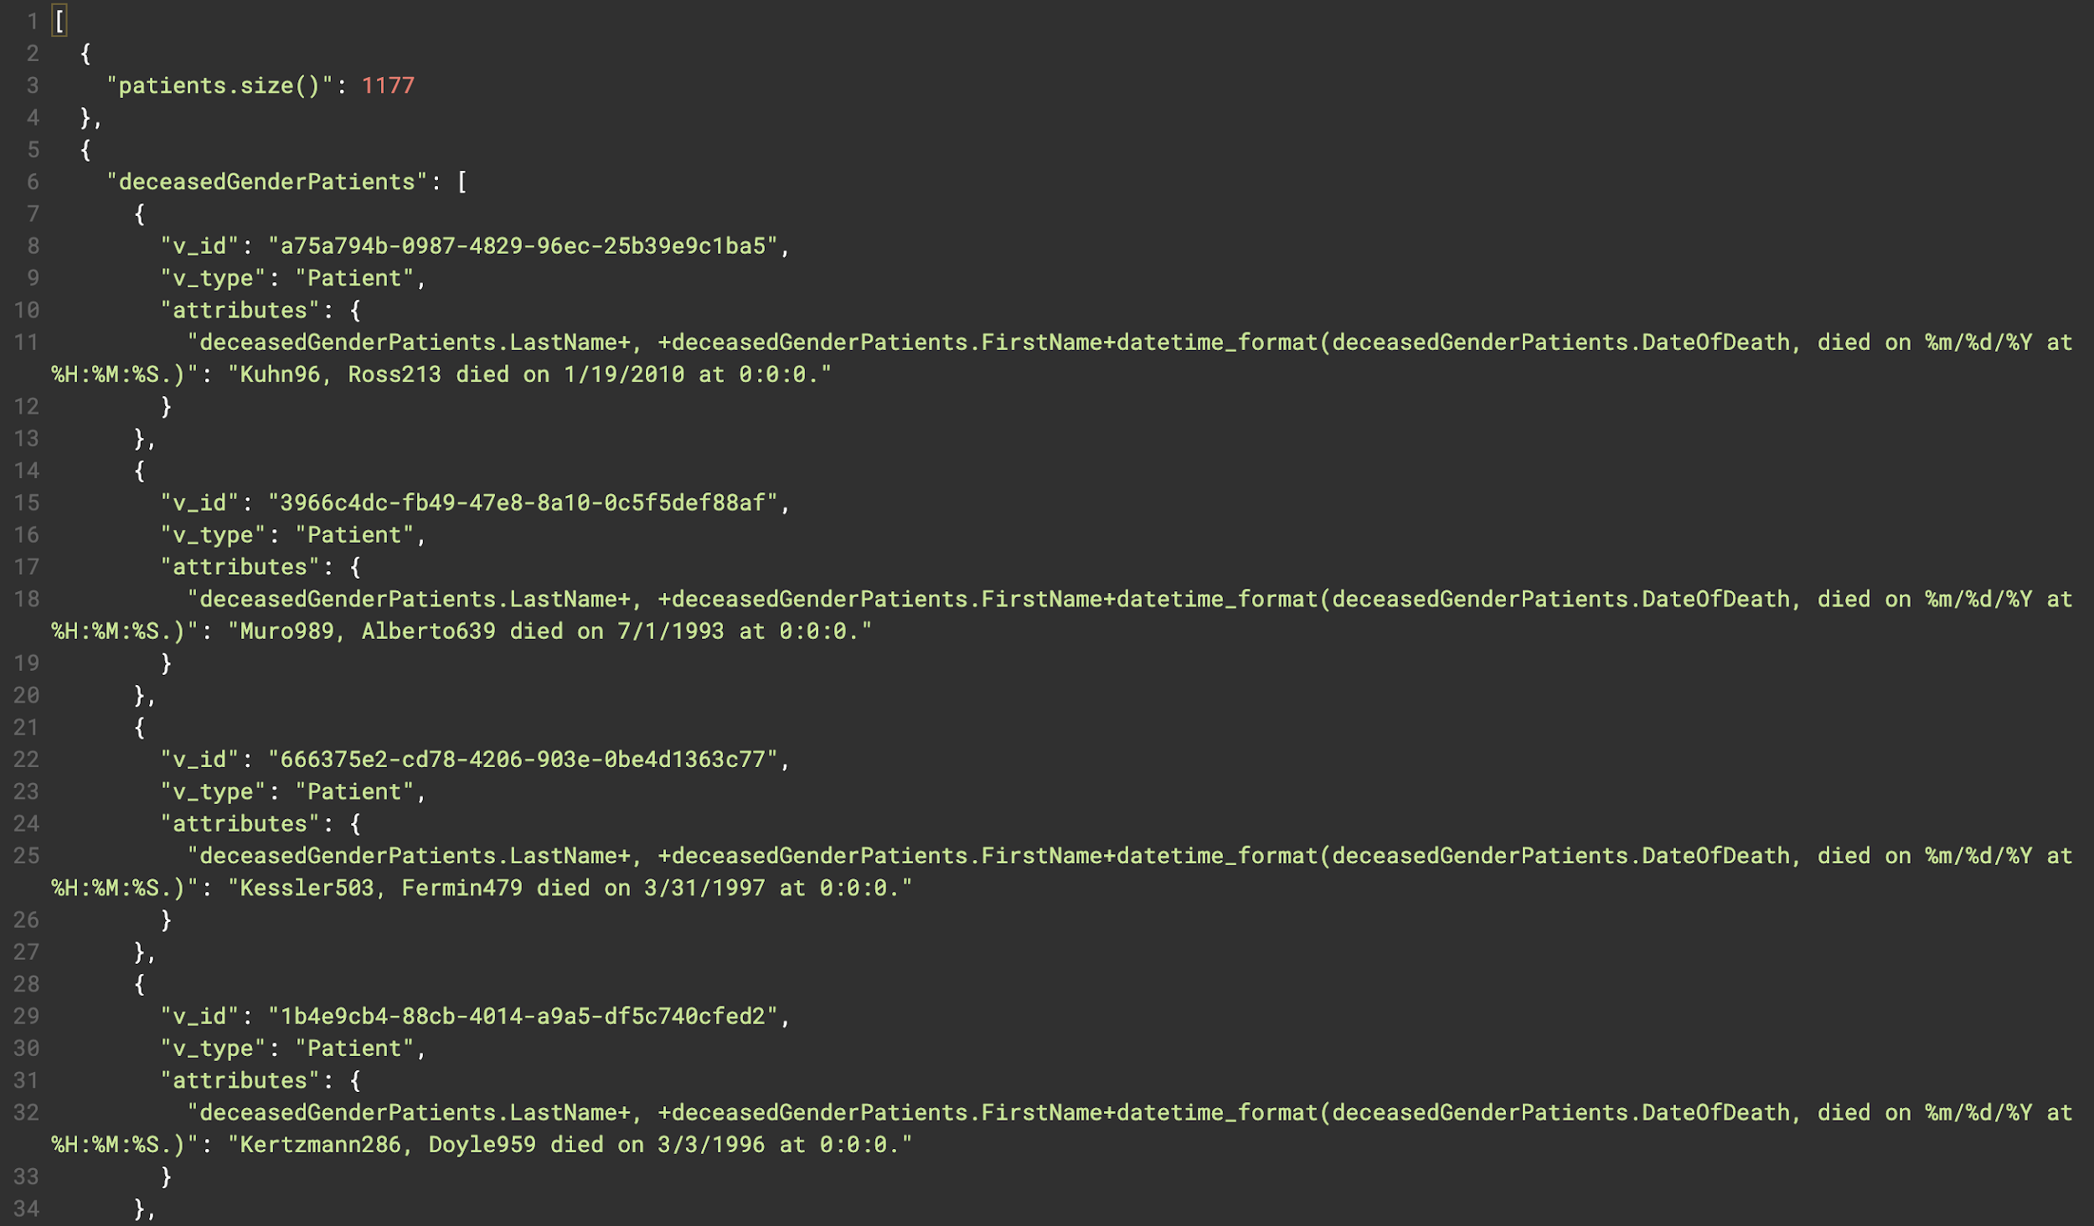
Patient Query Example
Run the query in TigerGraph studio to see the same output as running from the GSQL CLI

Slide 55
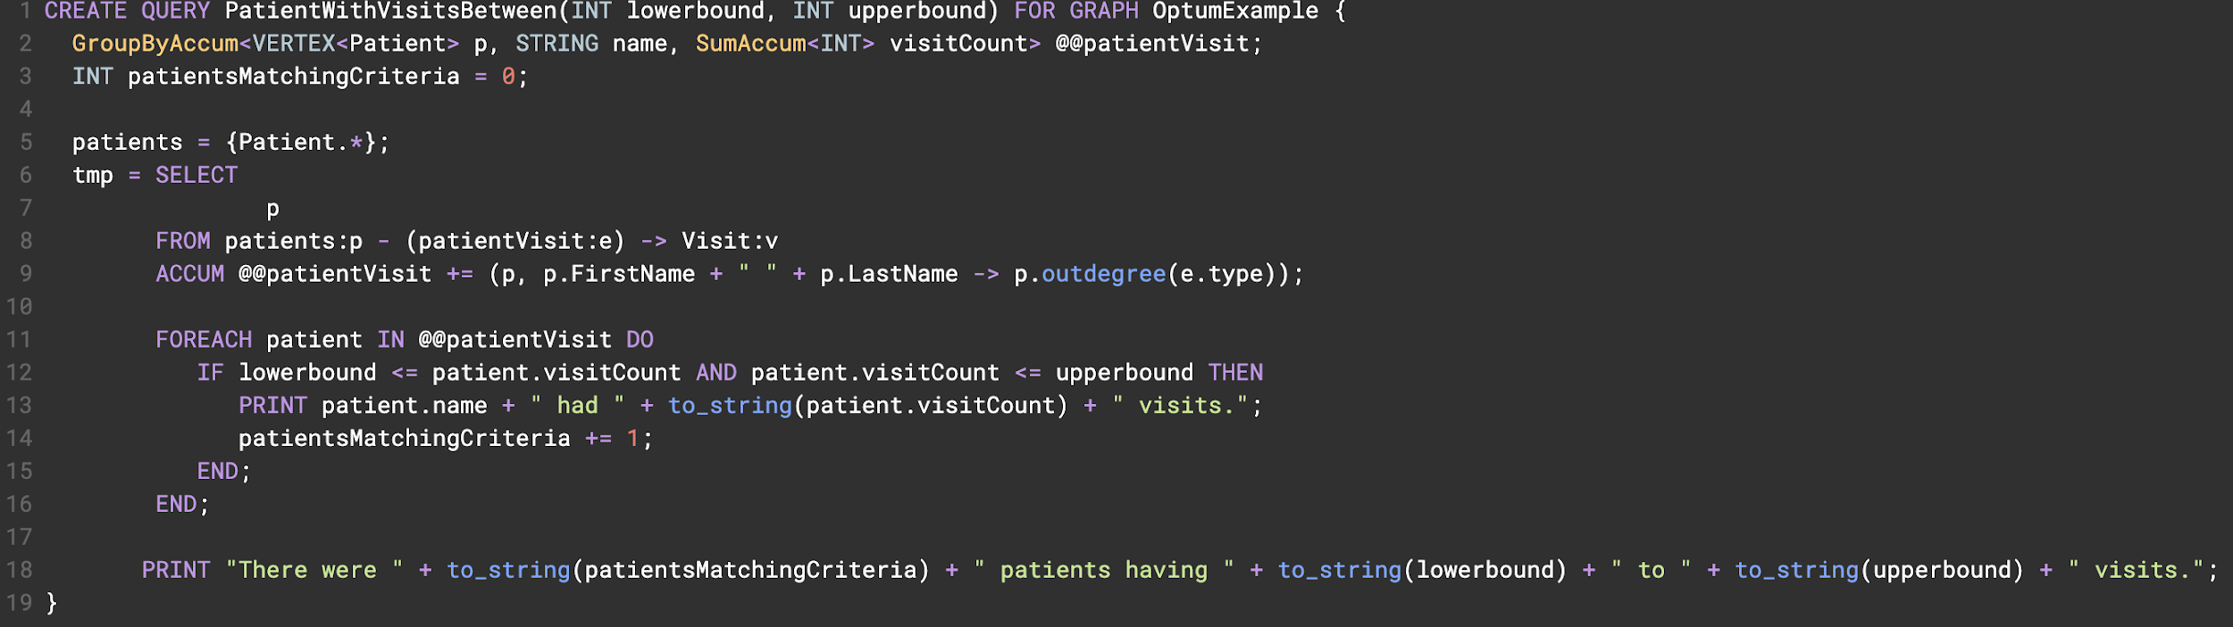
Vertex Degree Example Query
Now look at the “PatientWithVisitsBetween” query
How many patients had 4 to 10 visits?
Which patient had the fewest visits?

Slide 56
Exercise 4 Querying Data in TigerGraph
Write a query for all patients whose last names start with “L”
How many patients had a visit on “2019-05-17 00:00:00”?

Slide 57
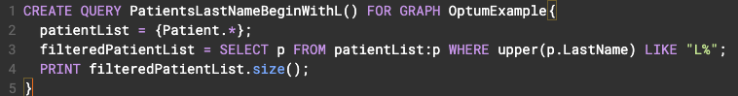
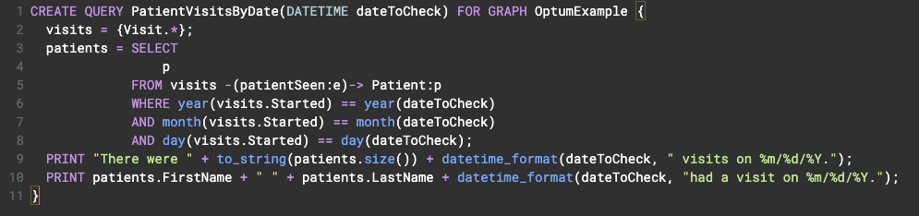
Exercise 4 Querying Data in TigerGraph
Write a query for all patients whose last names start with “L”
How many patients had a visit on “2019-05-17 00:00:00”? 8 Patients
8 Patients

Slide 58
Section 5
Introduction to Graph Modeling

Slide 59
Synthea Data Generator
When modeling it is important to have an understanding of what data is available and how that data will be queried and analyzed.
Synthea Data Generator can provide connected data relevant to the healthcare industry.
More information on Synthea can be found at https://github.com/synthetichealth/synthea
In preparation for this section execute “gradle loadExercise5”

Slide 60
Synthea Data Entities
The Synthea data generator will produce the following entities and associated relationships
Allergies
Care Plans
Conditions
Encounters
Imaging Studies
Immunizations
Medications
Observations
Patients
Procedures
Providers

Slide 61
Patient Centric Clinical Model
Allergies
HAS
HAS
Care Plan
Patient
HAS
Condition
HAS
HAS
Imaging
HAS
Medication
Encounter
HAS
Observations
Organization
Procedure
Provider

Slide 62
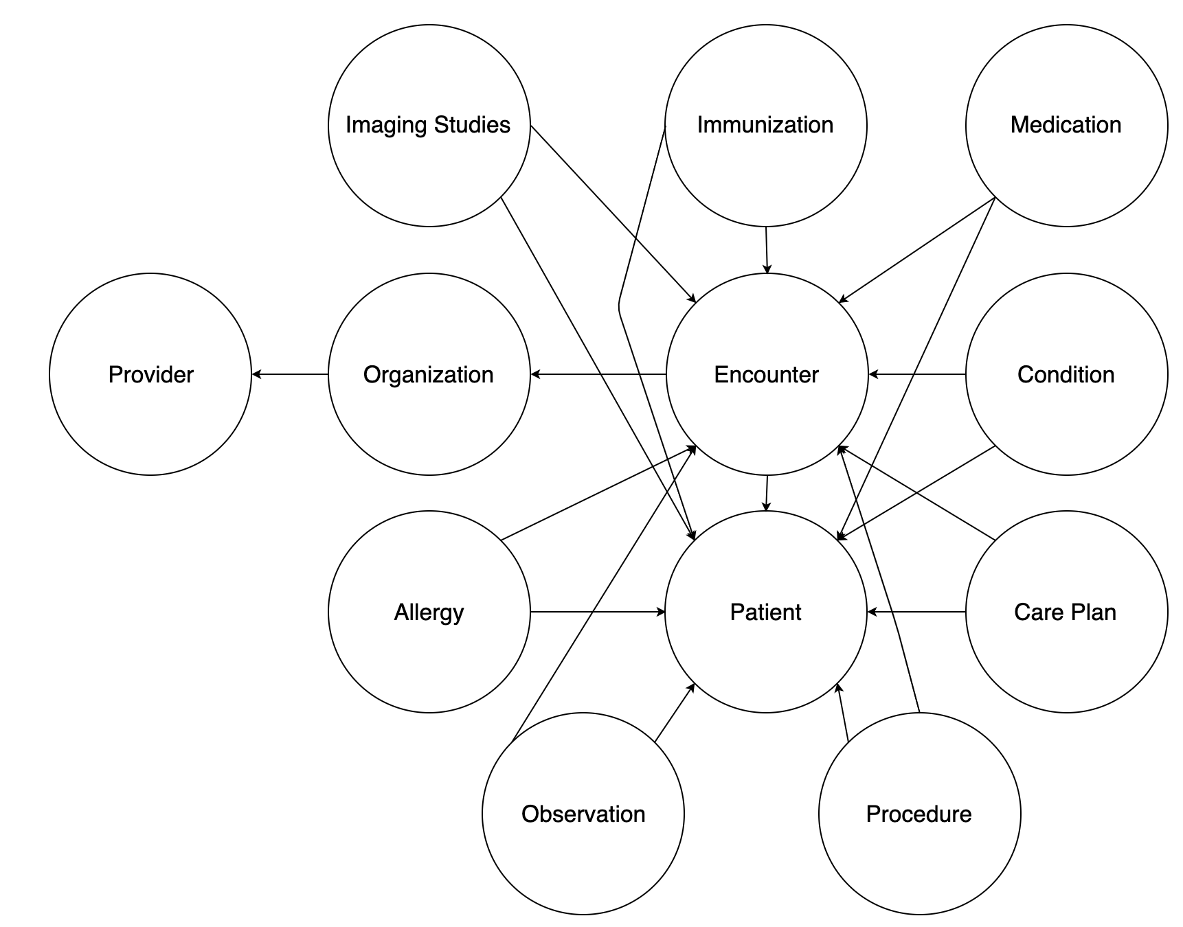
Synthea Schema
The Synthea data follows the relational model
The full model can be explored at
https://github.com/synthetichealth/
synthea/wiki/CSV-File-Data-Dictionary
This course will make use of data
provided by Synthea, but will not necessarily
adhere to the schema provided by Synthea.

Slide 63
A few notes on this model
There are no claims in this model
Providers are frequently related to many organizations and organizations contain many providers
There are no genomics or IoT data in the model

Slide 64
Converting RDBMS Schema to Graph Schema
When a traditional relational schema exists it is not uncommon to have the following transformations when converting to a graph database.
Tables become Vertex Types
Columns in tables become attributes for the corresponding vertex
Rows in tables become vertices in the graph
Carry over constraints, such as uniqueness of certain properties
Foreign keys become relationships between two vertices
Join tables become relationships and any columns become relationship properties
These will be demonstrated using the Synthea RDBMS models

Slide 65
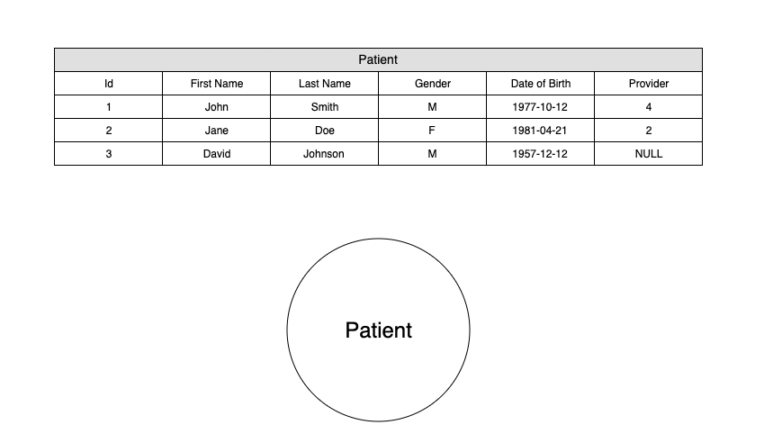
Tables to Vertex Types
Transform tables that represent entities into vertex types.
For example the following Synthea data tables make sense to transform to vertex types
Patient
Provider
Organization
Patient table to Patient Vertex

Slide 66
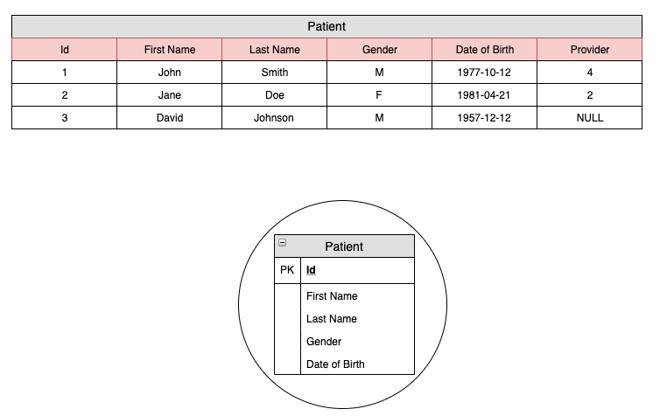
Columns to Properties
Columns that define the structure of the Patient entity will become
properties
Properties for a vertex type should describe the underlying entity.
Foreign Key Columns should not be carried over as properties
The properties that are chosen should be considered through the lens of how data will be queried and interacted with in the graph database.
Choosing the properties of a vertex type will greatly influence the overall architecture of the graph model
Patient Columns to Patient Properties

Slide 67
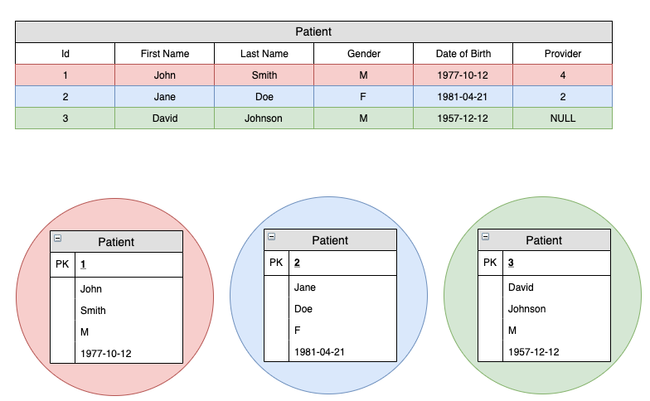
Record Rows to Vertices
Individual record rows will be transformed into instances of a given vertex type
The volume of records of a given vertex type should be considered when modeling
What are consequences of modeling a vertex type that has very few records?

Slide 68
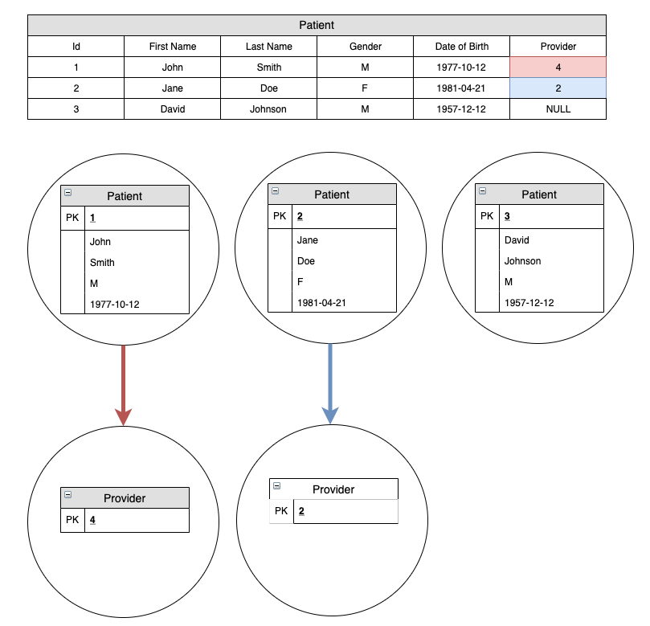
Foreign Keys Become Relationships
Foreign key values will be transformed into relationships
In RDBMS some foreign keys are nullable.
If a foreign key is null then a relationship simply doesn’t exist

Slide 69
Constraints
Constraints from RDBMS should be carried over for example
Uniqueness of values
Enumerated Values
Datatype restrictions
Constraint options vary by graph provider.

Slide 70
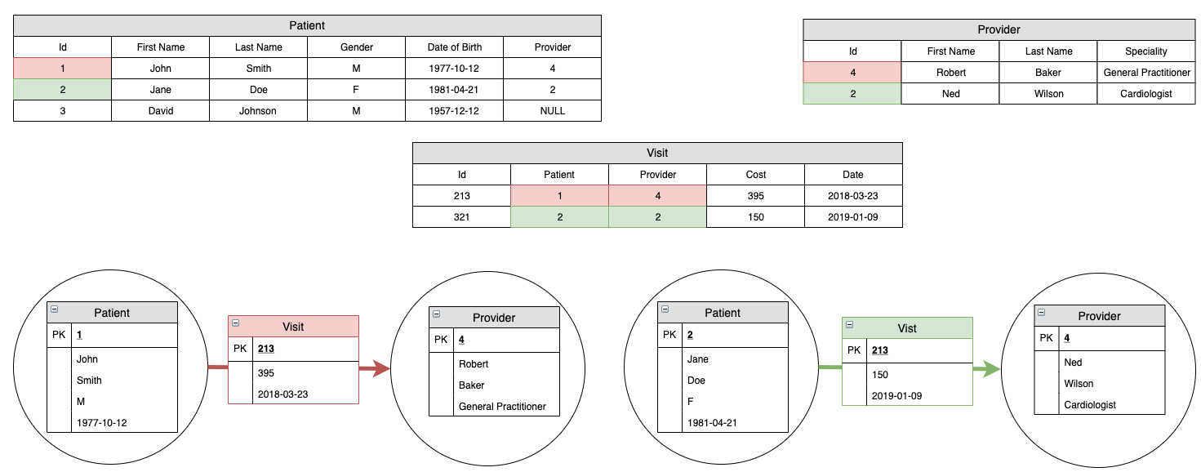
Join Tables to Edges with Properties
Join tables, much like foreign keys can be conceptualized as
edges with properties
What happens if John Smith visits Dr. Baker more than once?

Slide 71
Cardinality of Properties and Edges
The cardinality of properties and edges can also vary from graph provider to graph provider.
Property values can be Single, List, or Set
Edge cardinality refers to if more than once instance of given edge type can exist between the same instance
Patient X “visits” Doctor Y, there would be multiple versions of a visit between the instance of X and Y
Both cardinality of properties and edges is an important consideration when developing a graph model as it can greatly impact the final architecture of the graph model.
Having the constraint of only having one edge between X and Y limits the overall relationships that can be expressed

Slide 72
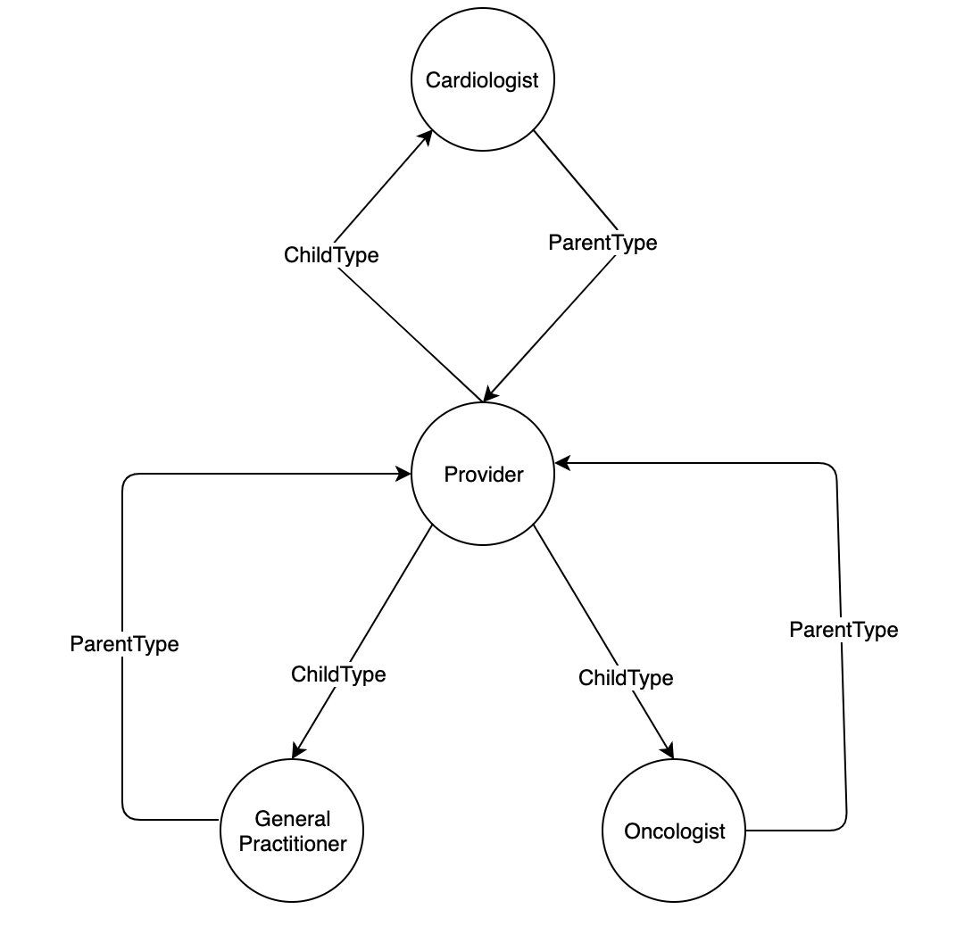
Vertex Subtyping
It is possible to also model OOP principles with vertices.
For example in the Synthea data model “Providers” have a speciality. These specialties can be conceptualized as sub-classifications of “Providers”, such as “General Practitioner”, “Oncologist” or “Cardiologist”

Slide 73
Graph Modeling Antipatterns
When beginning to model graph schemas it is best to start by whiteboarding. Graph databases do not have the rigid required schemas as relational databases.
However two common issues that tend to arise when initially designing a graph model.
Supernodes
Entities mischaracterized as Relationships

Slide 74
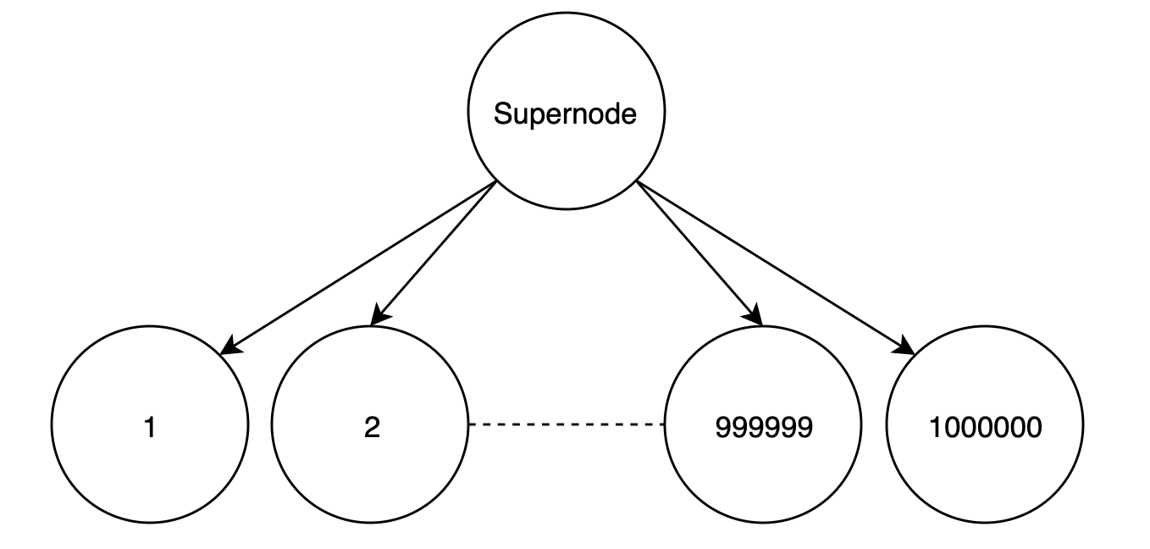
Supernodes
Graph databases are focused on relationships to single instances of an entity. One anti-pattern to be aware when modeling for a graph database are Supernodes.
A Supernode is a vertex that has a disportionately high amount of incident edges. What constitutes a high amount? It varies between different graph providers

Slide 75
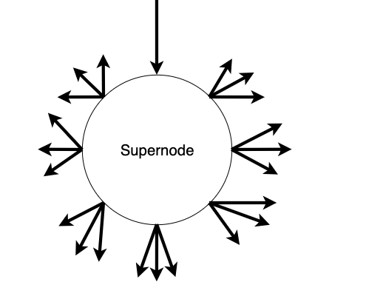
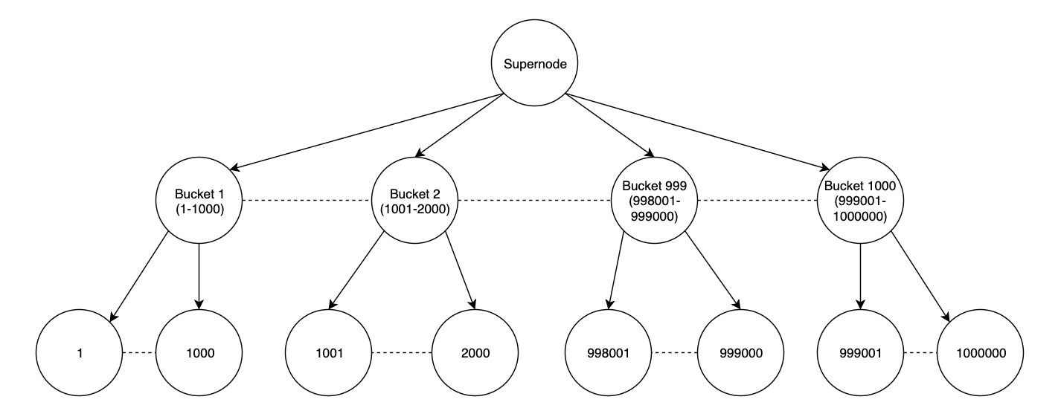
Supernode Mitigation
Supernodes may still be required or need to exist for a given model.
Traversal through a supernode that is a costly operation.
Especially when the majority of the relationships must be explored for most queries.
The best strategy is to group or bucket relationship types through vertex typing, so queries can be against a smaller subset.

Slide 76
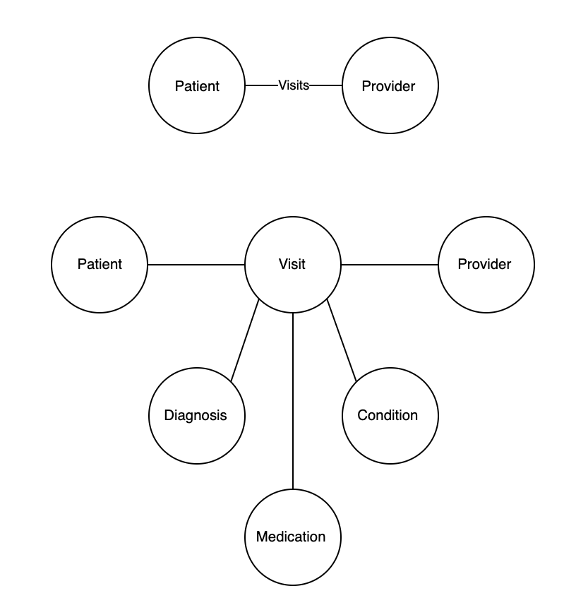
Relationship Expansion
Another anti-pattern to be cognisant of is relationships that can be contracted or expanded.
Relationships can sometimes be better served as a vertex type.
The simplification of a patient visiting a provider.
This obscures additional important relationships of events that happened at a given visit

Slide 77
Exercise 5 Implementing the Synthea Data
Using the provided files; allergies.csv, medications.csv, organizations.csv and procedures.csv extend the current model to answer the following:
What allergies does patient “Owen89 Hahn503” have?
What organization does provider “Cedrick207 Runte676” work for?
What medication has patient “"Mel236 Reinger292” taken?
What procedures has patient “Danny396 Pollich983” had?

Slide 78
Exercise 5 Implementing the Synthea Data
Using the provided files; allergies.csv, medications.csv, organizations.csv and procedures.csv extend the current model to answer the following:
What allergies does patient “Owen89 Hahn503” have?
Shellfish Allergy
What organization does provider “Cedrick207 Runte676” work for?
Good Samaritan Medical Center
What medication has patient “"Mel236 Reinger292” taken?
Amoxicillin 250 mg and Clavulanate 125 mg, Naproxen Sodium 220 mg
What procedures has patient “Danny396 Pollich983” had?
Sputum Examination and Documentation of Current Medications

Slide 79
Section 6
Geospatial Modeling

Slide 80
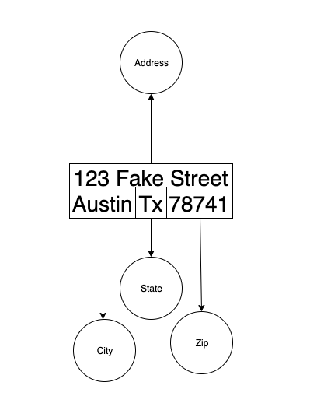
Geospatial Modeling Based on Address
One of the easiest and best way to represent physical locations are with addresses
Patient “X” resides at
123 Fake Street Austin Tx 78741
What are the logical components of a typical address?
Street Address
City
State
Zip

Slide 81
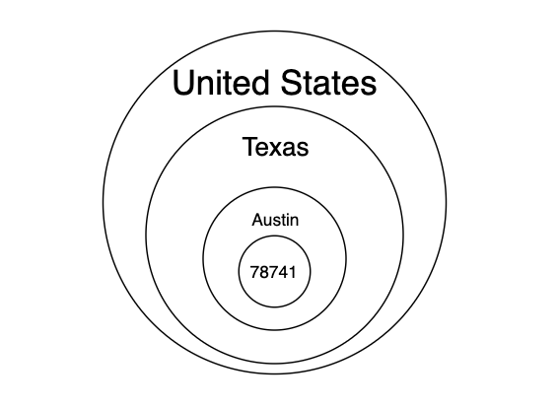
Geospatial Supernode
When defining relationships to physical locations it may be tempting to create relationships between all relevant vertices in the geospatial subgraph.
This will lead to supernodes.
How many patients live on a given street as opposed to in a city, or in a zip, state or even country?

Slide 82
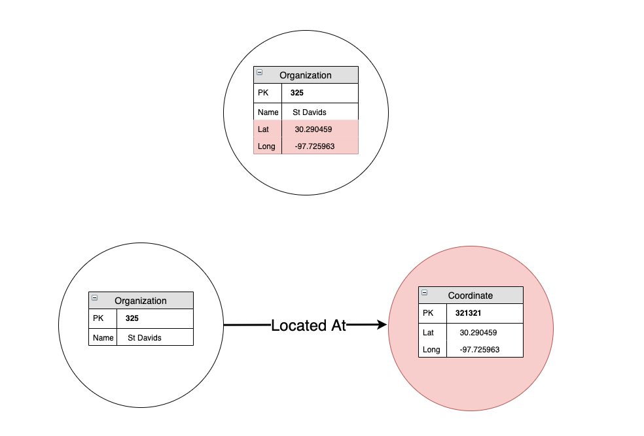
Geospatial Modeling using Coordinates
Another common way to imbue spatial awareness is to leverage the concepts of Latitude and Longitude.
Should these be properties on specific objects?
Should there be type of vertex that generalizes “Coordinate” that contains Latitude and Longitude?

Slide 83
Geospatial Graph Function
The importance of geospatial awareness can be seen by the built functions offered by the different graph providers.
Most implement Haversine as a way to calculate geodesic distance.
Neo4J’s Cypher has built in functionality that can calculate distance between points.
As with all modeling the choice of graph provider can impact certain design decisions to help improve efficiencies when interacting with the graph.

Slide 84
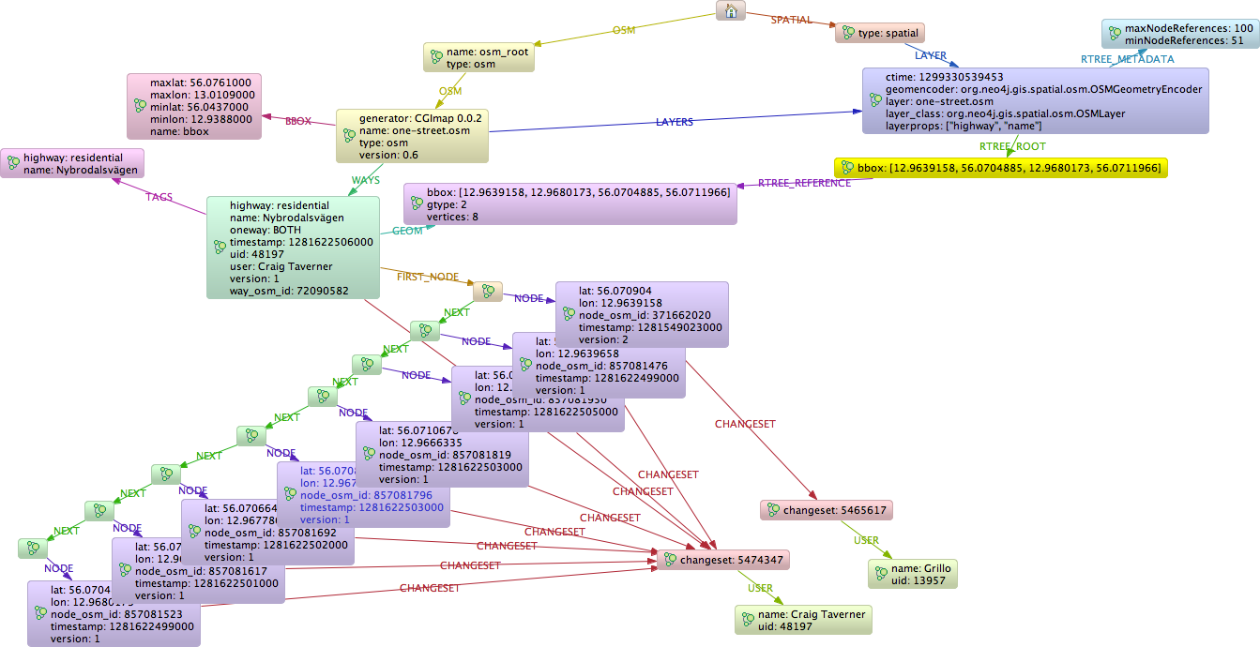
Neo4J Spatial
Neo4j Spatial is a library of utilities designed for Neo4j
Key Features
Utilities to import ESRI Shapefile and Openstreetmap files
Supports points, linestrings, polygons, etc.
Supports topological operations like contains, covers, intersects, etc

Slide 85
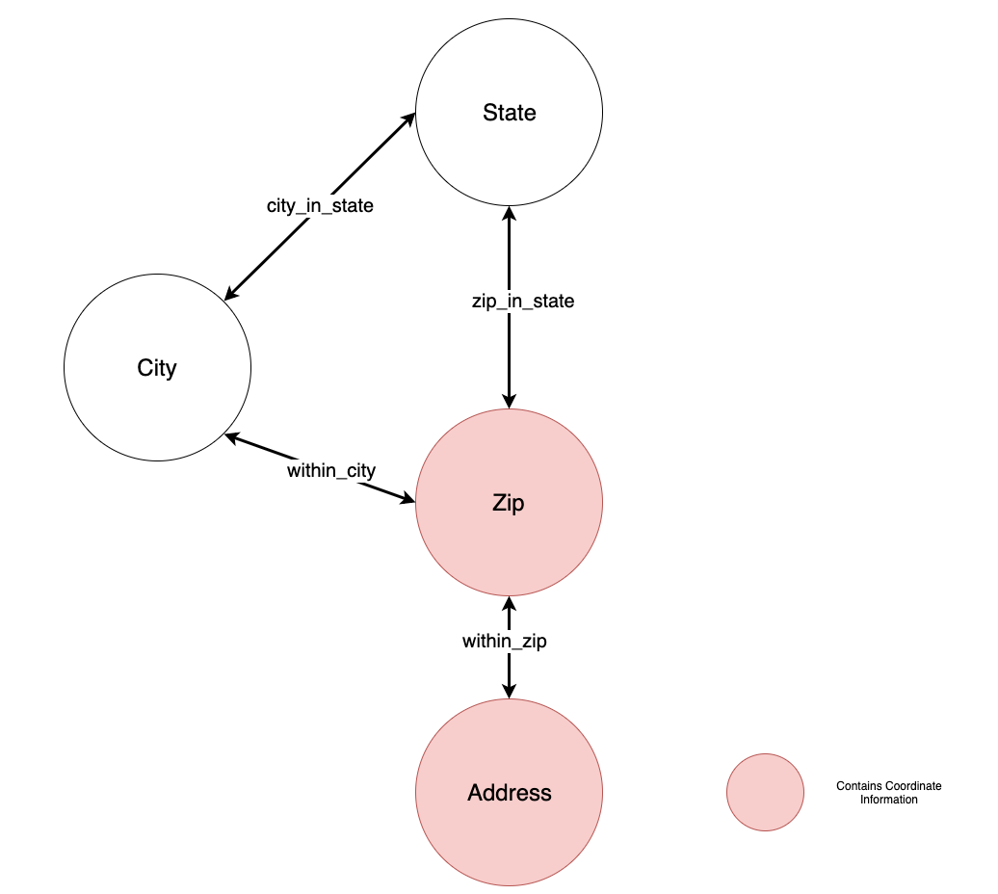

Optum Geospatial Model
The optum geospatial model combines both addresses and coordinate information where appropriate.
The above reduced schema will be sufficient and works well with the generated Synthea data

Slide 86
Exercise 6 Geospatial Modeling
Extend the current geospatial model to the Optum geospatial model using the “zips.csv” file by adding county and country vertex types and appropriate edge types and connections.
Using the provided “HaversineDistance” query from loadExercise6, which of these patients: “Leslie90 Ritchie586”, “Kendall673 Kuhic920”, or “Siobhan540 Konopelski743” is closest to the organization “Newton-Wellesley Hospital”?

Slide 87
Exercise 6 Geospatial Modeling
Extend the current geospatial model to the Optum geospatial model using the “zips.csv” file by adding county and country vertex types and appropriate edge types and connections.
Using the provided “HaversineDistance” query from loadExercise6, which of these patients: “Leslie90 Ritchie586”, “Kendall673 Kuhic920”, or “Siobhan540 Konopelski743” is closest to the organization “Newton-Wellesley Hospital”? Leslie90 Ritchie586

Slide 88
Temporal Modeling

Slide 89
Event Based Modeling
Time series event based modeling in graph databases can be tricky as many naive approaches can easily lead to supernodes.
For example if a care provider needed to record and monitor a patient’s vitals during an exercise or test to determine a diagnosis.

Slide 90
Event Based Modeling Options
When storing event based data in a graph database it is important to consider the following:
The frequency of the updates. Will events happen seconds between each other or days between each other?
The quantity and grouping of events. Is there a logical grouping, such that the reads can be limited and resultant sets are small?

Slide 91

Time Tree
The time tree does help bucket and provide however the common datetime issues are still present, like tracking timezone offsets
What are the consequences of being too granular or not being granular enough when first constructing a time tree?
One way to model event based data is the use of a Time Tree
The leaf nodes of
the time tree
can then be
related to
singular
events

Slide 92
Other Time Series Options
Remember graph databases excel in certain areas, but are not the best storage solution for all areas. It may sometimes make more sense to leverage another database. There are advantages and disadvantages to this approach:
Advantages
Storage and retrievals of time series may already be fine tuned in a temporal database
May offer time series functionality to facilitate rollups and statistics
Disadvantages
Would be another system to manage and maintain
Cross database joins are always costly

Slide 93
Bitemporal Modeling
Bitemporal modeling has two time dimensions, time of an event and validity time. Essentially all data becomes immutable and no information is ever disregarded. Bitemporal modeling provides the following information when analyzing data:
Provides accurate snapshot of the data at current point in time
Provides historical information to get a snapshot of the data at any point time
Provides a way to compare the historical changes that occurred to explain the current snapshot of the data

Slide 94

State and Identity Vertices
One way to model bitemporal is through the use of Identity Vertices (Peach) and State Vertices (Blue).
For example tracking the growth and remission of a tumor for patient “X”.
What if the measurements were recorded incorrectly?

Slide 95

Validity State
A key aspect of bitemporal modeling being able to review all history, even incorrect entries. One way is to attach a validity node to the individual state nodes
For example say the measurements taken on 2016-09-17 were entered incorrectly and only noticed on the next visit on 2016-09-22

Slide 96

Validity State Vertices
Despite the initial erroneous entry there is now auditable trail to show how the record was changed.
The difficulty with State and Identity vertices can be seen in the structural changes that are required in regards to new vertices and edges.
What if edge properties were recorded incorrectly?

Slide 97
Graph Database Impact on Temporal Modeling
As with any modeling it is important to realize how the choice of graph storage and graph engine variations can impact decisions.
Always learn about the built in features and efficiencies of a specific implementation, or lack thereof, before modeling.

Slide 98
Exercise 7 (Optional)
Add State and Identity Nodes to the existing schema for Conditions

Slide 99
Conclusion and Closing Remarks

Slide 100
Final Remarks
As with RDBMS when modeling for graph database the first question that must be answered is the interaction and querying of the data.
Addressing this first may also give insight to if a particular graph database provider is preferable over others due to built in efficiencies or functionality

Slide 101
Further Reading
TigerGraph
https://www.tigergraph.com/
TigerGraph GSQL
https://doc.tigergraph.com/attachments/gsql_ddl_loading_v2.1.pdf
https://doc.tigergraph.com/attachments/gsql_query_v2.1.pdf
Neo4J
https://neo4j.com/
Neo4J Spatial
https://github.com/neo4j-contrib/spatial

Slide 102
Thank you! Questions?

